Slide 1
Oracle Java SE Subscriptions; Protect Your Investment in Java SE
Minimize Risk, Reduce Effort, Maximize Reliability of your Java deployments

Slide 2
Safe Harbor Statement
The following is intended to outline our general product direction. It is intended for information purposes only, and may not be incorporated into any contract. It is not a commitment to deliver any material, code, or functionality, and should not be relied upon in making purchasing decisions. The development, release, and timing of any features or functionality described for Oracle’s products remains at the sole discretion of Oracle. Not all technologies identified are available for all cloud services.
Disclaimer
The information in this document may not be construed or used as legal advice about the content, interpretation or application of any law, regulation or regulatory guideline. Customers and prospective customers must seek their own legal counsel to understand the applicability of any law or regulation on their processing of personal data, including through the use of any vendor’s products or services.

Slide 3
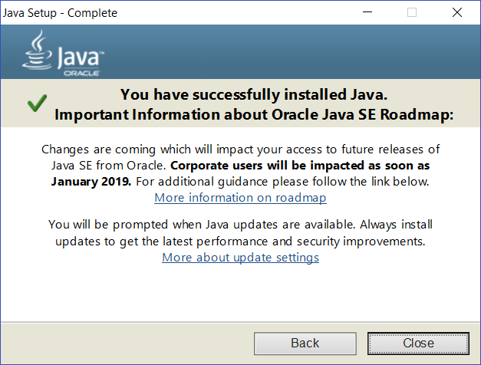

Slide 4
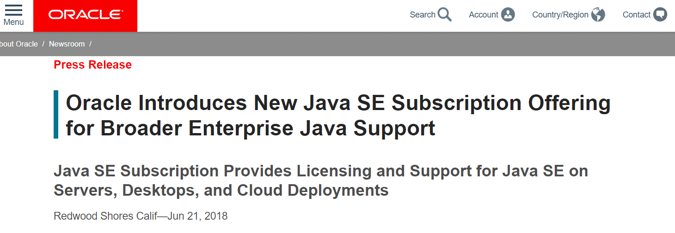
https://www.oracle.com/corporate/pressrelease/java-se-subscription-offering-062118.html

Slide 5
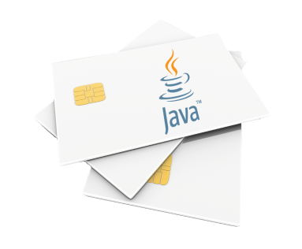
JAVA is everywhere
Servers
Desktop
Embedded
TV
Mobile
Card
Java EE
Java SE
Java ME
Java Card
Java Language
Copyright © 2017, Oracle and/or its affiliates. All rights reserved.
5

Slide 6
There are 38 billion active Java Virtual Machines.
12 Million Developers Run Java.
Java is the #1 Development Platform
Oracle is the main contributor and steward of Java SE.

Slide 7
The “Java Community Process” decided to alter the Java SE Release Cadence to remain the #1 Development Platform position for the next 20 years

Slide 8
New Java Release Timeline*
Oracle JDK – Public Updates
OracleJDK
JDK 6
OpenJDK - GPL
JDK 7
JDK 8
JDK 9
JDK 10
JDK 11 LTS
JDK 12
JDK 13
JDK 14
JDK 15
JDK 16
JDK 17 LTS
2017
2018
2019
2020
2021
2022
2023
2024
2025
* Dates and version numbers subject to change
LTS = Long term support release

Slide 9
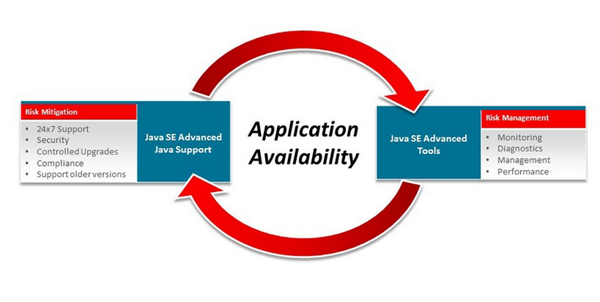
Java SE Subscription covers all active Java versions: *please see slide of Java releases for active Java versions
Java Mission Control
Java Flight Recorder
Advanced Mmt Console
Java Usage Tracker
Deployment Rule Set
Java MSI Installer

Slide 11
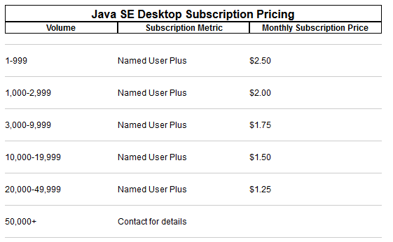
Java SE Desktop Subscription

Slide 12
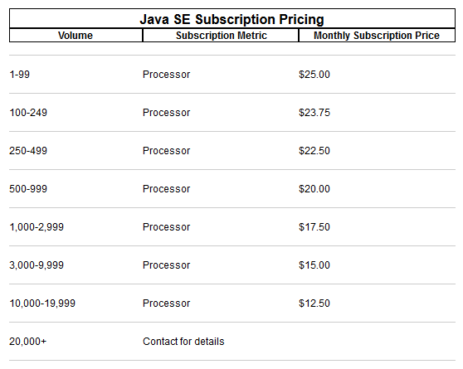
Java SE Server Subscription

Slide 13
Benefits for Java SE Subscriptions
Security and critical updates for all Java environments
Quick turnaround for critical issues with access to intermediate patches
Efficient management, control and deployments of all Java versions installed on desktops and servers
Reduced development and operational costs due to less migration and testing

Slide 14
Facts I.
Java 8 update 202 is the last public update for Java 8 (free).
Oracle Java 1.8 is the latest version which includes Java Web Start and Applet / Java Plug-in.
Java usage fee is not a license fee, but is a subscription fee and the contract to be signed will mean subscription
Subscription fee to be calculated by desktops, in case of servers fees to be calculated by physical processor cores
Many cases Weblogic Standard Edition has better TCO than Java SE subscription
No Java subscription fee to be payed when Customer uses Oracle product which is built on Java SE technology
For usage of Oracle development tools (e.g. JDeveloper, SQL Developer) JDK does not need to be licensed

Slide 15
Facts II.
WLS licenses are not intended to grant licenses for Java for non-WLS usage
For the old versions, Java8, last patching set published on January 2019, if you want to get all the future patches, security etc you need to buy Java SE subscription including test&dev environments.
So, depending on the Java version we are talking about. Starting with Java 11 there is other licensing policy agreement. https://www.oracle.com/technetwork/java/javase/terms/license/javase-license.html It means that for the test&dev environment you are entitle to use the Oracle JDK without buying Java SE subscription
The only available tool to see your internal Java usage is the Java usage tracker (requires Java SE subscription)
Virtual environments – no changes

